Slide 1
Classical Time Series Analysis
Saran Ishika Maiti
Department of Statistics, Visva-Bharati
Santiniketan

Slide 2
What is Time Series?
A Time series is a set of observations, each one being recorded at a specific time. (Annual GDP of a country, Sales figure, water flow of a river overetc)
A discrete time series is one in which the set of time points at which observations are made is a discrete set. (All above including irregularly spaced data)
Continuous time series are obtained when observations are made continuously over some time intervals. It is a theoretical Concept.( Roughly, ECG graph).
A discrete valued time series is one which takes discrete values. (No of accidents, No of transaction etc.).
A discrete time series consists of data points separated by time intervals that are greater than one second
A continuous time series contains one data point usually measured per second

Slide 3
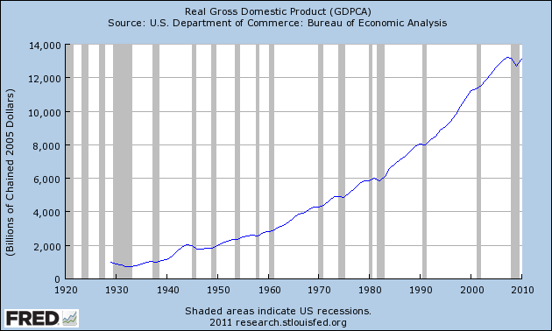
Few Time series Plots Remember for a time series plot time points are drawn along the major axis Remember for a time series plot value of the variables will always be joined by a line
Annual GDP of USA

Slide 4
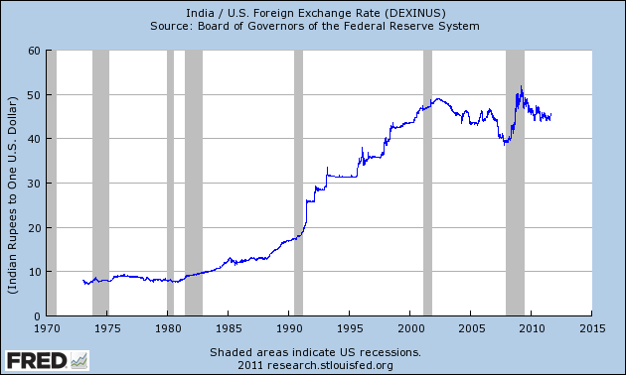
A discrete time series is one in which the set of time points at which observations are made is a discrete set. (All above including irregularly spaced data)

Slide 5
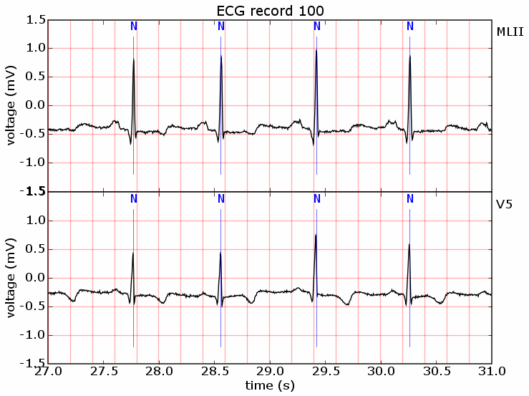
Continuous time series are obtained when observations are made continuously over some time intervals. (ECG graph).

Slide 6
Continuous time series data (Stock returns):

Slide 7
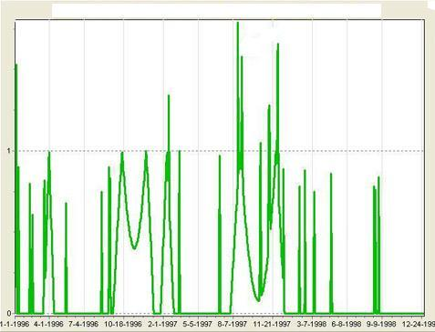
A discrete valued time series is one which takes discrete values. (No of accidents, No of transaction etc.). Time series plot on car accident in U.K.

Slide 8
Few points on Plots
Plot help us to summarize and reveal patterns in data
Graphics help us to identify anomalies in data
Plot helps us to present a huge amount of data in small space and makes huge data set coherent.
To get all the features of a plot ‘aspect ratio’ of plot is very crucial.
The ratio of height to width of a plot is called the aspect ratio.
Aspect ratio makes a plot visually appealing and more balanced.

Slide 9
Aspect ratio
Aspect ratio of a square is 1:1 while aspect ratio of a ideal rectangular landscape format is 3:4.
Generally in time series plot aspect ratio is expected to be around 0.618.
However, for long time series data aspect ratio should be around 0.25.
To understand the impact of aspect ratio see the following two plots

Slide 10
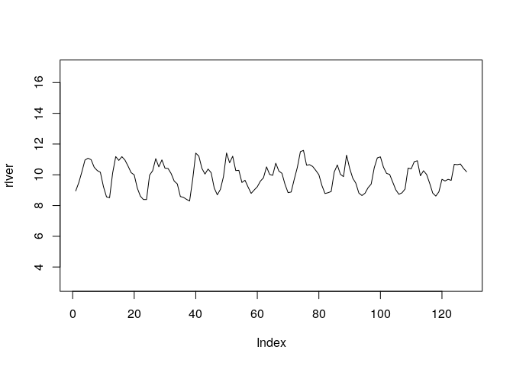
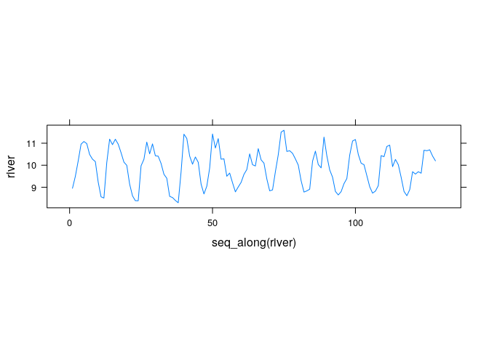
Aspect ratio= 5
Aspect ratio= .2

Slide 11
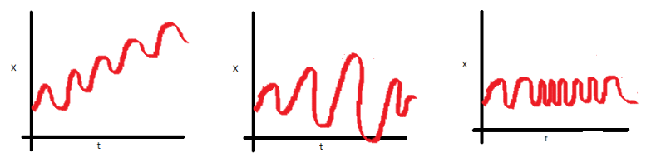
Stability of time series: Concept of Stationarity
Stationarity means that the statistical properties (usually mean, variance, covariance) of a time series (or rather the process generating it) do not change over time. Unless a time series is stationary it is not ready for further analysis as well as future prediction is not possible.
From a time series plot one can roughly guess on time series stability aka stationarity
Look at the three plots below
Mean increases with time-a clear upward trend
No trend but span of each cycle varying
Spread becomes closer as time increases
Nonstationarity:
Unstable time series

Slide 12

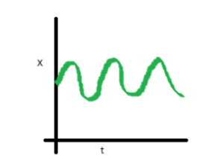
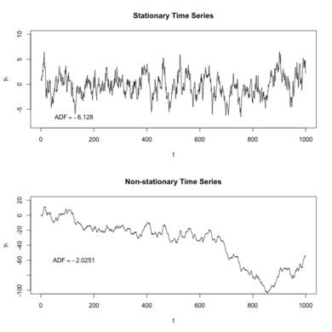
How does a stationary time plot look then ?
In this case mean , variance and covariance are
constant with time

Slide 13

Two Different Approaches of Explanation
Old/Classical/Traditional Approach
Modern/Stochastic Process Approach
It is not that modern approach is better than the classical approach.
Looking into the same time series from different perspective.
OLD WINE IN NEW BOTTLES.

Slide 14
By classical Approach Time Series Components
Notes:
17

Slide 15
Time Series Components
Trend
Notes:
18

Slide 16
Time Series Components
Trend
Cyclical
Notes:
19

Slide 17
Time Series Components
Trend
Cyclical
Seasonal
Notes:
20

Slide 18
Time Series Components
Trend 2. Periodic Component 3. Irregular/error component
Under periodic component two components-cyclical, seasonal
Trend
Cyclical
Seasonal
Irregular
Notes:
21

Slide 19
Trend Component
Persistent, smooth,regular, long-term movement, usually overall upward or downward pattern
Several years duration
Response
Mo., Qtr., Yr.
Notes:
22

Slide 20
Trend Component
Overall Upward or Downward Movement
Data Taken Over a Period of Years
Sales
Upward trend
Time

Slide 21
Cyclical Component
Repeating up & down movements
With uniform period and a uniform amplitude (height)
Usually 2-10 years duration
Cycle
Response
Mo., Qtr., Yr.
Notes:
23

Slide 22
Cyclical Component
Upward or Downward Swings
Cycles in economic time series are not strictly periodic
Use of average period of the cycles
Sales
Cycle
Time

Slide 23
Seasonal Component
Regular pattern of up & down fluctuations
Period is not longer than one year
Occur due to weather, customs etc.
Daily, monthly, quarterly or yearly data
Summer
Response
Mo., Qtr.
Notes:
24

Slide 24
Seasonal Component
Upward or Downward Swings
Regular Patterns
Observed Within One Year
Winter
Sales
Time (Monthly or Quarterly)

Slide 25
Irregular Component
Erratic, unsystematic, ‘residual’ fluctuations,unexplained
Due to random variation or unforeseen events
Union strike
War
Natural calamities e.g. flood, storm etc.
Short duration & nonrepeating
Notes:
25

Slide 26

Looking into the Time Series
Any time series is composed of any combinations of four components.
Tt :Secular Trend.
St: Seasonality.
Ct :Cyclical Component.
It : Irregular component.
Mathematically, Yt=f(Tt, St,Ct, It) where f being a function
In classical approach this function f can be either simple multiplicative or simple additive

Slide 27
Variations in Time Series…..
Secular Trend: Long Term change in the mean level.
The smooth, regular, long term movement.
Problem: How long is long?
Some part of a oscillating series with a very long cycle may look like an upward or downward trend.

Slide 28
Example of Trend
Quarterly GDP of USA

Slide 29
Variation In Time series….
Seasonal variation: Periodic movement of a time series where the period is not longer than one year. Seasonality is always of a fixed and known period. Hence, seasonal time series are sometimes called periodic time series.
A periodic movement in a series is one which recurs or repeats at regular intervals of time.
Examples:
1.The passenger traffic during 24 hours.

Slide 30
Seasonal variation….
2. Sales of a departmental store during the 12 months of a year.
3. Unemployment rate is high in winter and low in summer.
4. Sales of wine/chocolates/apparels will be high at Christmas time and low at some other time.

Slide 31
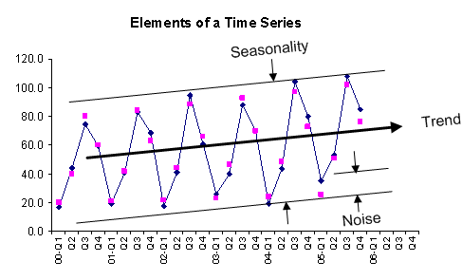
Quarterly Sales of Ice-cream Q1-Dec-Jan

Slide 32
Purpose of Studying Seasonality
Efficient running of a shop; keeping inventory ready for the boom season; employing more number of employee for the boom period.
Seasonal variation in vegetable price series is less prominent for developed country as compared to developing countries!! Infrastructure---cold-storage, food processing industry.

Slide 33
Variation of Time Series…..
Cyclical Component: The oscillatory component in a time series where the period of oscillation is more than one year.
One complete period is called a cycle.
Length of cycle, intensity of cycle, occurrence of cycle are not fixed and unpredictable.
The duration of these fluctuations is usually of at least 2 years.
Think of business cycles which usually last several years, but where the length of the current cycle is unknown beforehand
EXAMPLE: Every economy goes through prosperity (boom) and depression.

Slide 34
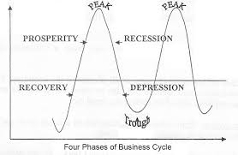
General look of a business cycle
Steady growth line
Regarding US economy, National Bureau of Economic research
defined eleven cycles spanning from 1945 to the year 2009, with the average cycle
lasting a bit over 5-1/2 years.

Slide 35
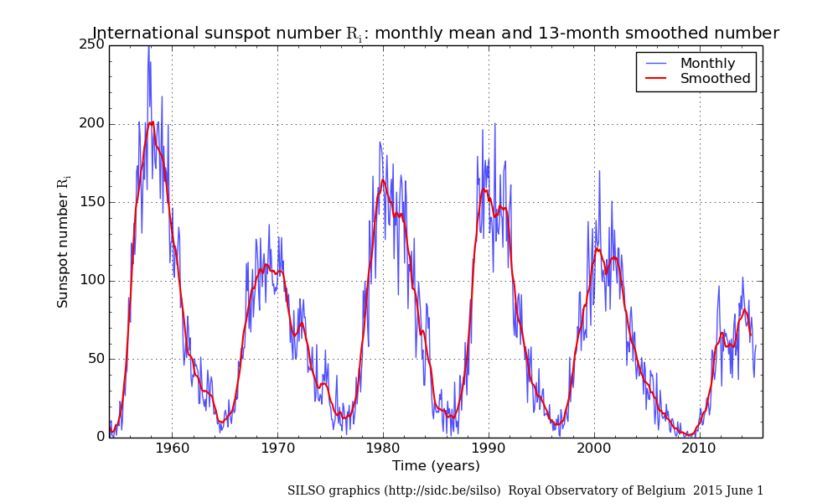
Time series data (Number of sunspots) showing cycles:
Sunspots are temporary phenomena on the Sun's photosphere that appear as spots darker,cooler than the surrounding areas
The number of sunspots that can be seen on the surface of sun increases and decreases
in a regular pattern known as a solar cycle with a maximum number of sunspots occurring every 11.5 years

Slide 36
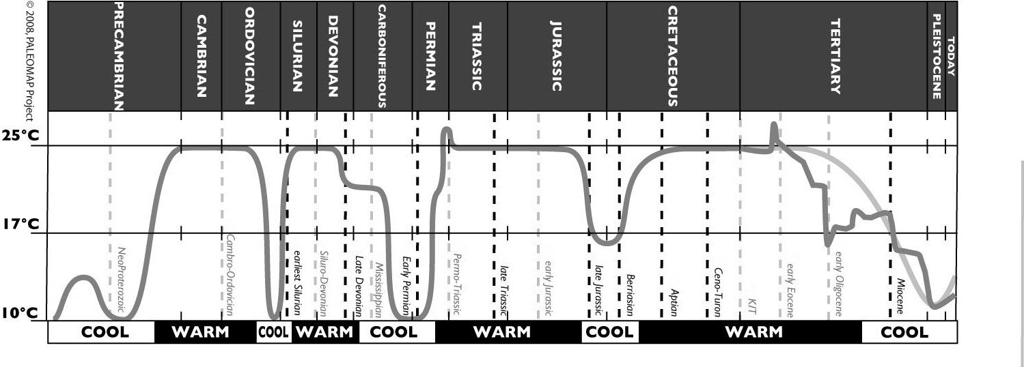
Global average temperature: Each cycle has length of few million years.

Slide 37
Irregular Component
The left over part which are completely unaccountable or are due to unforeseen events as wars, floods, strike.

Slide 38
Complete visualization

Slide 39
Components at a glance

Slide 40
Danger with Plot
Generally a plot speaks a thousands words.
However, plot needs to be studied carefully.
Following plots elaborate---plot does not speak so many words as well----need for mathematical modeling.

Slide 41
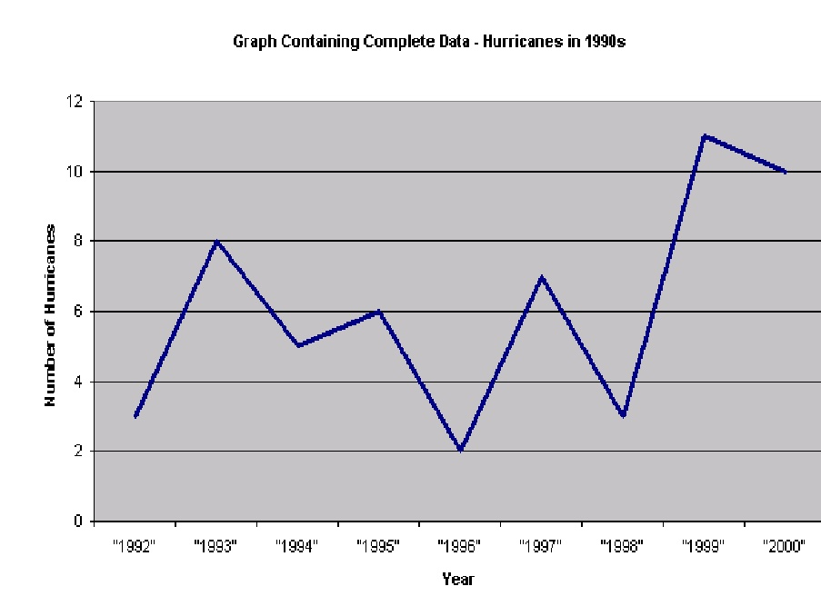
A Time series plot:

Slide 42
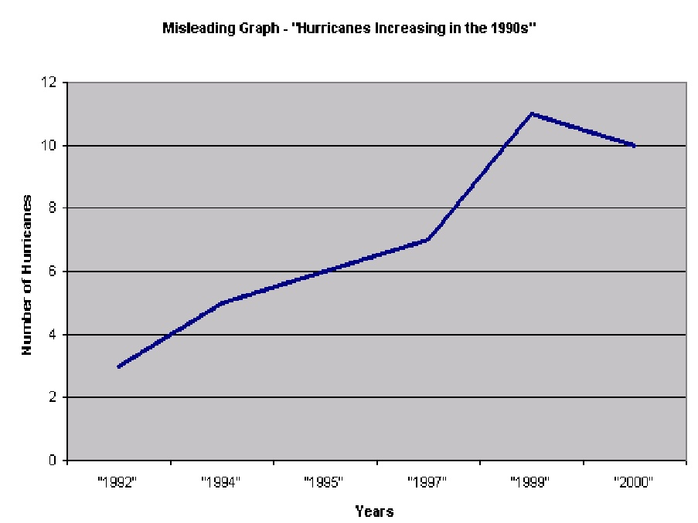
Effect of omission of data on the Time series plot:

Slide 43
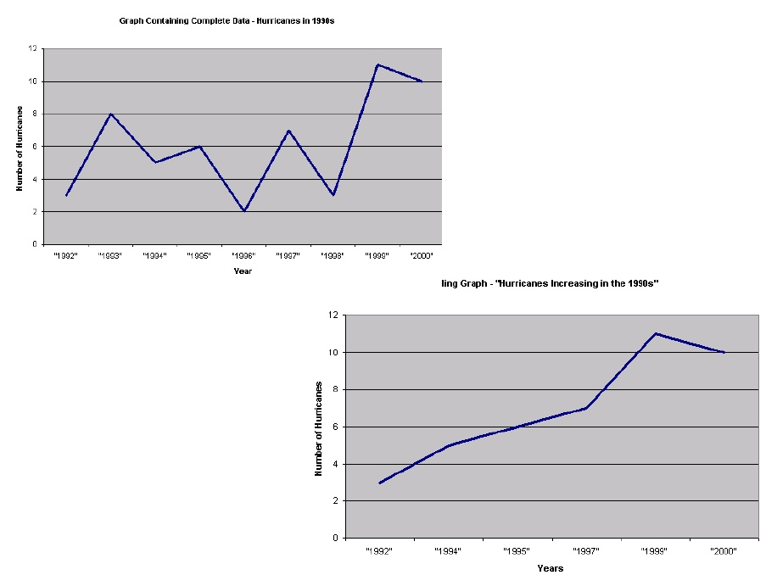
Effect of omission of data on the Time series plot:

Slide 44
Trend could be misleading due to scale effect:
80
10000
8000
60
6000
y
40
y
4000
20
2000
0
0
0
5
10
15
20
0
5
10
15
20
t
t

Slide 45
Confusing kind of trend due to other type of scaling
80
80
60
60
y
40
y
40
20
20
0
0
0
5
10
15
20
0
1
2
3
t
Log t
4.5
4.5
4
4
3.5
3.5
Log y
Log y
3
3
2.5
2.5
0
5
10
15
20
0
1
2
3
t
Log t

Slide 46
Formal (classical) Treatment of Time Series Data
Decomposition of a time series (Y_{t}) into its components:
Trend (T_{t})
Cycle (C_{t})
Seasonal (S_{t})
Irregular (I_{t})
Different combinations of the above components:
A: Y_{t}= T_{t} ^{x} C_{t} ^{x} S_{t} ^{x} I_{t} ⟶ Multiplicative Model (Most Popular)
B: Y_{t}= T_{t} ⁺ C_{t} ⁺ S_{t} ⁺ I_{t} ⟶ Additive Model (Less Popular)
C: Y_{t}= T_{t} ^{x} C_{t} ^{x} S_{t} ⁺ I_{t} ⟶ Mixed Model
D: Other Combinations ⟶ Mixed Model

Slide 47
Formal (classical) Treatment of Time Series Data When to use Additive Model
In some time series, the amplitude of both the seasonal and irregular variations do not change as the level of the trend rises or falls.
In such cases, an additive model is appropriate. In the additive model, the observed time series is considered to be the sum of three independent components.
Each of the three components has the same units as the original series.

Slide 48
Formal (classical) Treatment of Time Series Data When to use Multiplicative Model
In many time series, the amplitude of both the seasonal and irregular variations increase as the level of the trend rises.
In this situation, a multiplicative model is usually appropriate.
Under this model, the trend has the same units as the original series, but the seasonal and irregular components are unit less factors, distributed around 1.

Slide 49
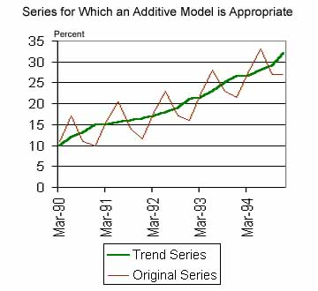
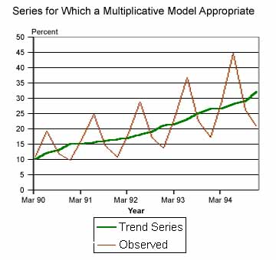
ADDITIVE VS MULTIPLICATIVE SEASONALITY

Slide 50
ADDITIVE VS MULTIPLICATIVE SEASONALITY
Seasonal components can be additive in nature or multiplicative. For example, during the month of December the sales for a particular toy may increase by 1 million dollars every year. Thus, we could add to our forecasts for every December the amount of 1 million dollars (over the respective annual average) to account for this seasonal fluctuation. In this case, the seasonality is additive.
Alternatively, during the month of December the sales for a particular toy may increase by 40%, that is, increase by a factor of 1.4. Thus, when the sales for the toy are generally weak, than the absolute (dollar) increase in sales during December will be relatively weak (but the percentage will be constant); if the sales of the toy are strong, than the absolute (dollar) increase in sales will be proportionately greater. Again, in this case the sales increase by a certain factor, and the seasonal component is thus multiplicative in nature (i.e., the multiplicative seasonal component in this case would be 1.4).

Slide 51
ADDITIVE VS MULTIPLICATIVE SEASONALITY
In plots of the series, the distinguishing characteristic between these two types of seasonal components is that in the additive case, the series shows steady seasonal fluctuations, regardless of the overall level of the series; in the multiplicative case, the size of the seasonal fluctuations vary, depending on the overall level of the series.

Slide 52
Additive and Multiplicative Models
1. No trend and additive seasonal variability
2. Additive seasonal variability with trend
3. Multiplicative seasonal variability with a trend.
4. Multiplicative seasonal variability with a non-linear trend.

Slide 53
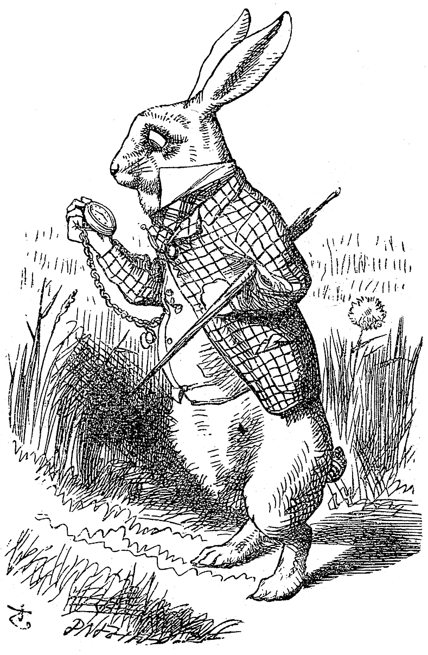
Any Questions?
If Not Lets have fun with R

Slide 54
Few time series data files available in R data repository sunspots, LakeHuron, nottem, UKDriversdeath, Nile, JohnsonJohnson, fdeaths, EUStockMarket etc. They are either Annual/quarterly/monthly/ daily data
Data description, variable value, no of observations
Convert the data in time series format (what additional features can you see? Start, end, frequency) , class of the data will be changed from numeric to time series (ts) .
From frequency you have the idea on time gap of the data,i.e. annual (frequency=1), monthly (frequency=12), quarterly(frequency=4), you can set the frequency as well.
From a large time series data you can take a part of data by “start” and “end” command.
Then plot the data
From plot check stationarity and presence of seasonality just by visual inspection.
Decompose the time series plot as well.

Slide 55
Example Install “stats” , “tseries” package
y<-sunspots
y1<-ts(y)
Class(y1)
y1<ts(y,start=c(1770,2),end=c(1831,8),frequency=12)
plot.ts(y1,col="blue",main="sunspots")
Z<-decompose(y1,type=c(“multiplicative”, “additive”))
plot(z)
U can only plot seasonal component
Plot(decompose$seasonal)

Slide 56
Exercise
Take a data “nottem” from r repository
Describe the data
What is the variable of interest here?
What is the frequency of the data?
Is it stationary?
Extract first 30 observations
Plot all the observations
Decompose the data
Is there cyclical component?
Is the model additive/multiplicative? Can you say it visually?

